Slide 1
IPD - Presentation

Slide 2
Progresses I have made:
Improved Stakeholders
Complete Project requirements
Designing Systems
Updated Gantt chart
Jupyter Notebook - prototype

Slide 3
Stakeholders
Stakeholders are individuals or organisations that are interested or are affected by the development and use of a software.
Identifying stakeholders is essential to ensure that the system requirements address both technical and practical needs
In case of my project, the stakeholders are people who use, have impact on the use of a anomaly detection system in financial environment and how they are involved

Slide 4
Stakeholders
Relationship
Bank admins are the primary users of the anomaly detection system. They are responsible for monitoring transactions, investigating suspicious activities and takin action when fraud is detected
Bank Administrators
Bank customers are indirectly affected by the system as it is only developed to protect their financial assets and personal activity from fraudulent activity
Bank Customers
IT operations
IT operations are also responsible for deploying the services, monitor uptime and handle failures and scaling issues

Slide 5
Stakeholders
Relationship
The legal and compliance officers are responsible for ensuring that the system follows regulations such as AML (Anti-Money Laundering) KYC (Know Your Customer) Fraud prevention policies
And Ensuring suspicious activities are detected, logged, investigated and reported to regulators
Legal & Compliance Officers
System Developer
The developers are directly involved as they create the system while having the requirements ready for them to implement. They are responsible for creating accurate, secure and accessible system.

Slide 6
Project Requirements
Project requirements are clear, agreed-upon statements of what a system must do and the constraints under which it must operate.
They define:
what the system should achieve
how well it should perform
what limits it must respect

Slide 7
Functional Requirements
Data Upload & Load - The system shall allow transaction data to be uploaded and loaded, ready to be used
Data Preprocessing- The dataset being used should be cleaned, transform, and prepared transaction data for model training and detection.
Model Training -The model should be trained using ML algorithms against the data that has been pre-processed
Anomaly Detection & Alerting – System should detect anomalous transactions and automatically generate alerts for administrator review.
Result Storage - The system shall store log events, detected anomalies, scores, and alerts for auditing and future analysis.
Result Visualization - The system should visualise anomalies and alerts in a clear and understandable format for administrators.
Model Update & Review The system shall support controlled model retraining and updates based on new data and evaluation results.

Slide 8
Non-Functional Requirements
Accuracy - The system should correctly distinguish normal and anomalous transactions with a target accuracy of 90–95%, minimising false positives while still detecting suspicious behaviour.
Efficiency - system should process transactions quickly, with minimal computational overhead, enabling timely detection
Security - system must ensure data confidentiality and integrity, protecting sensitive financial and customer information from unauthorized access.
Usability – it should be easy to use and accessible for admins, providing clear outputs such as understandable anomaly scores & explanation
Interpretability - The system should provide explainable results, enabling admins to understand why a transaction was flagged and support informed decision-making.
Reliability – it should produce consistent and stable results over time, ensuring dependable performance across different transaction patterns.
Scalability - The system should handle increasing transaction volumes without significant performance degradation.

Slide 9
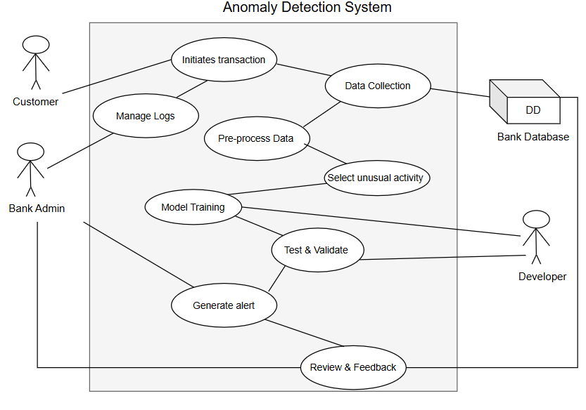
Overall System Designs
Use Case Diagram
This diagram illustrates the interaction between the actors(Customer, Admin, Database, System) and the events. The administrator interacts with most of the events such as uploading data, review and retrain the model if needed. Customer only performs the transactions. The system does the preprocessing of the data, the system will be trained to detect anomaly activities and the database provides the input data and the stores the results

Slide 10
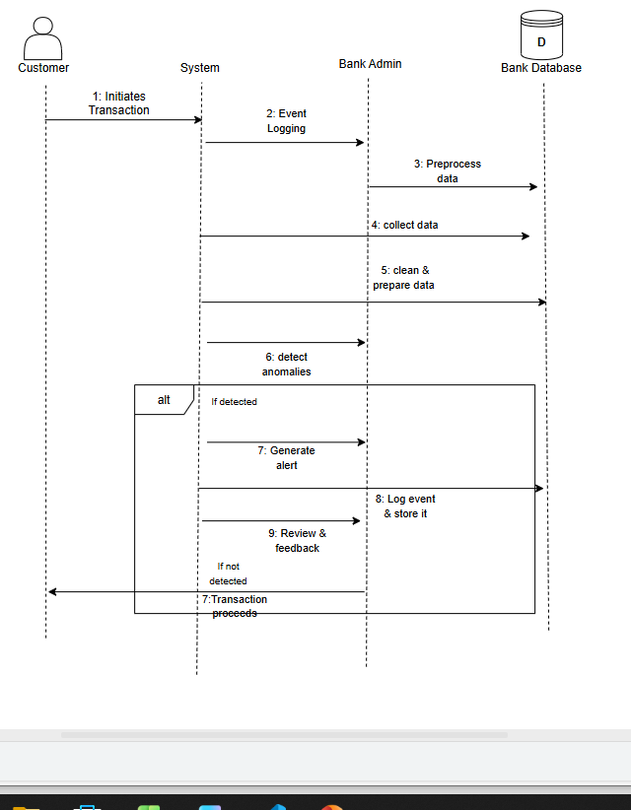
Overall System Designs
Sequence Diagram
Illustrates the sequence of events of the system once a customer initiates a transaction. The event will be logged by the admin and the system will proceed with the collection of data, the data will be pre-processed before training, cleaned. The system will then select the unusual activity and if it is detected of malicious, it will generate alert, this event will be logged, stored & then will be reviewed by the admin and given feedback to retrain or not. If unusual activity has not been detected the transaction will be proceeded.

Slide 11
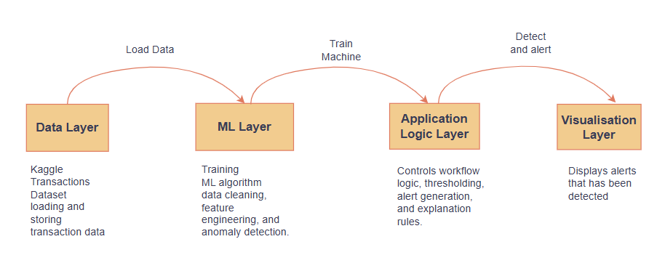
Overall System Designs
Layered Architecture Design
Illustrates the layers of the system which includes the data layer, where data is pre-processed/cleaned and loaded.
Machine Learning Layer where the algorithm is trained, feature engineering and detecting anomalies
Application Layer that controls the workflow using logics, thresholding and explanation rules
Visualisation Layer that displays the alert to the admin

Slide 12
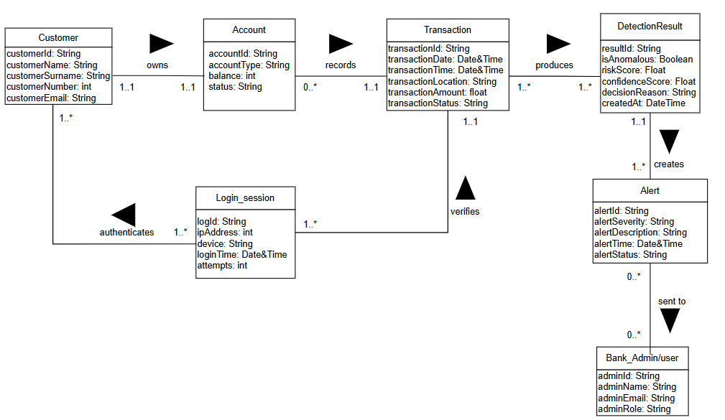
Overall System Designs
Class Diagram
A class diagram of the workflow of alert generation. A customer owns an account where the transactions will be recorded from. Before the transaction generates an alert, the login session verifies the transaction which is authenticates the customer who is trying to log in. After alert is generated, it is shown to the admin.

Slide 13
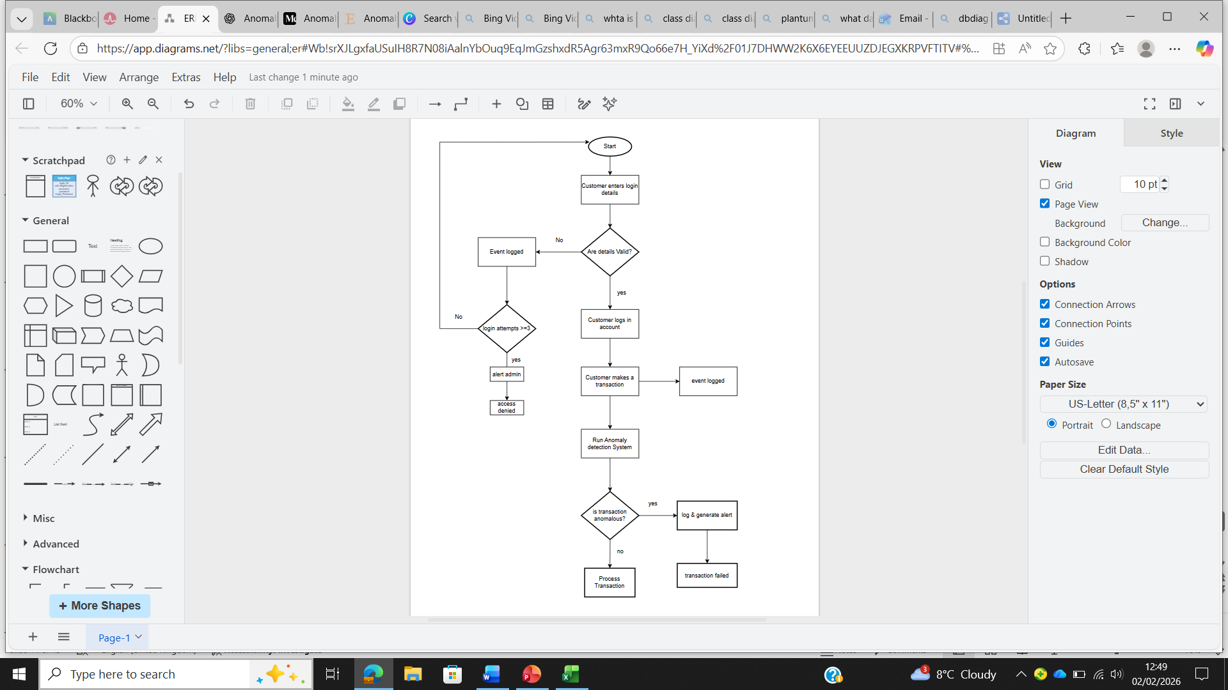
Overall System Designs
Workflow/flowchart
This diagram demonstrates the workflow of the detection system. Starting with customer entering login details, if login details are valid it will sign in else login again and if attempts reach greater than 3 it will deny access. After login customer makes a transaction and anomaly detection system is run, checking whether the transaction is anomalous. If its not anomalous, the transaction will proceed as is else, it will be logged and generate an alert to the admin and transaction would fail

Slide 14
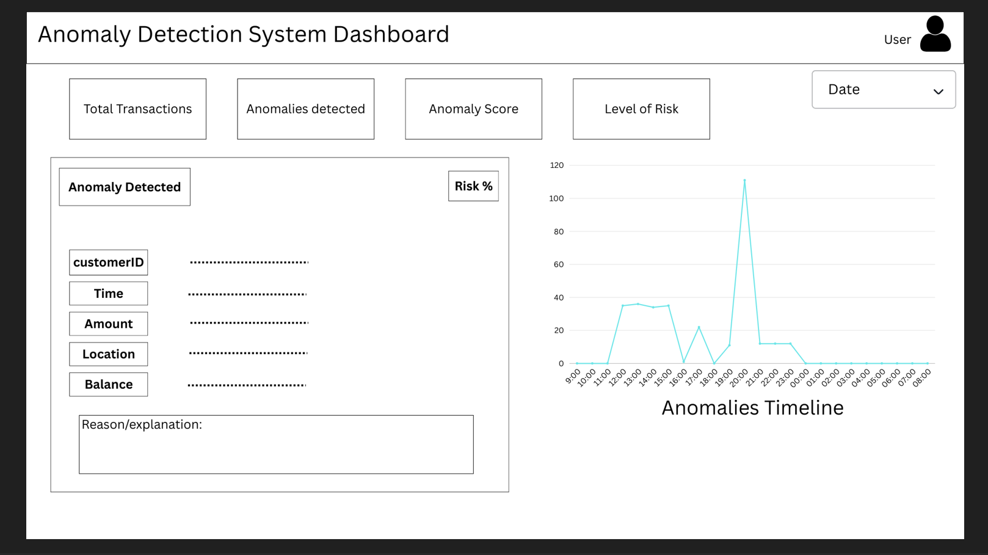
Overall System Designs
User Interface – System Dashboard

Slide 15
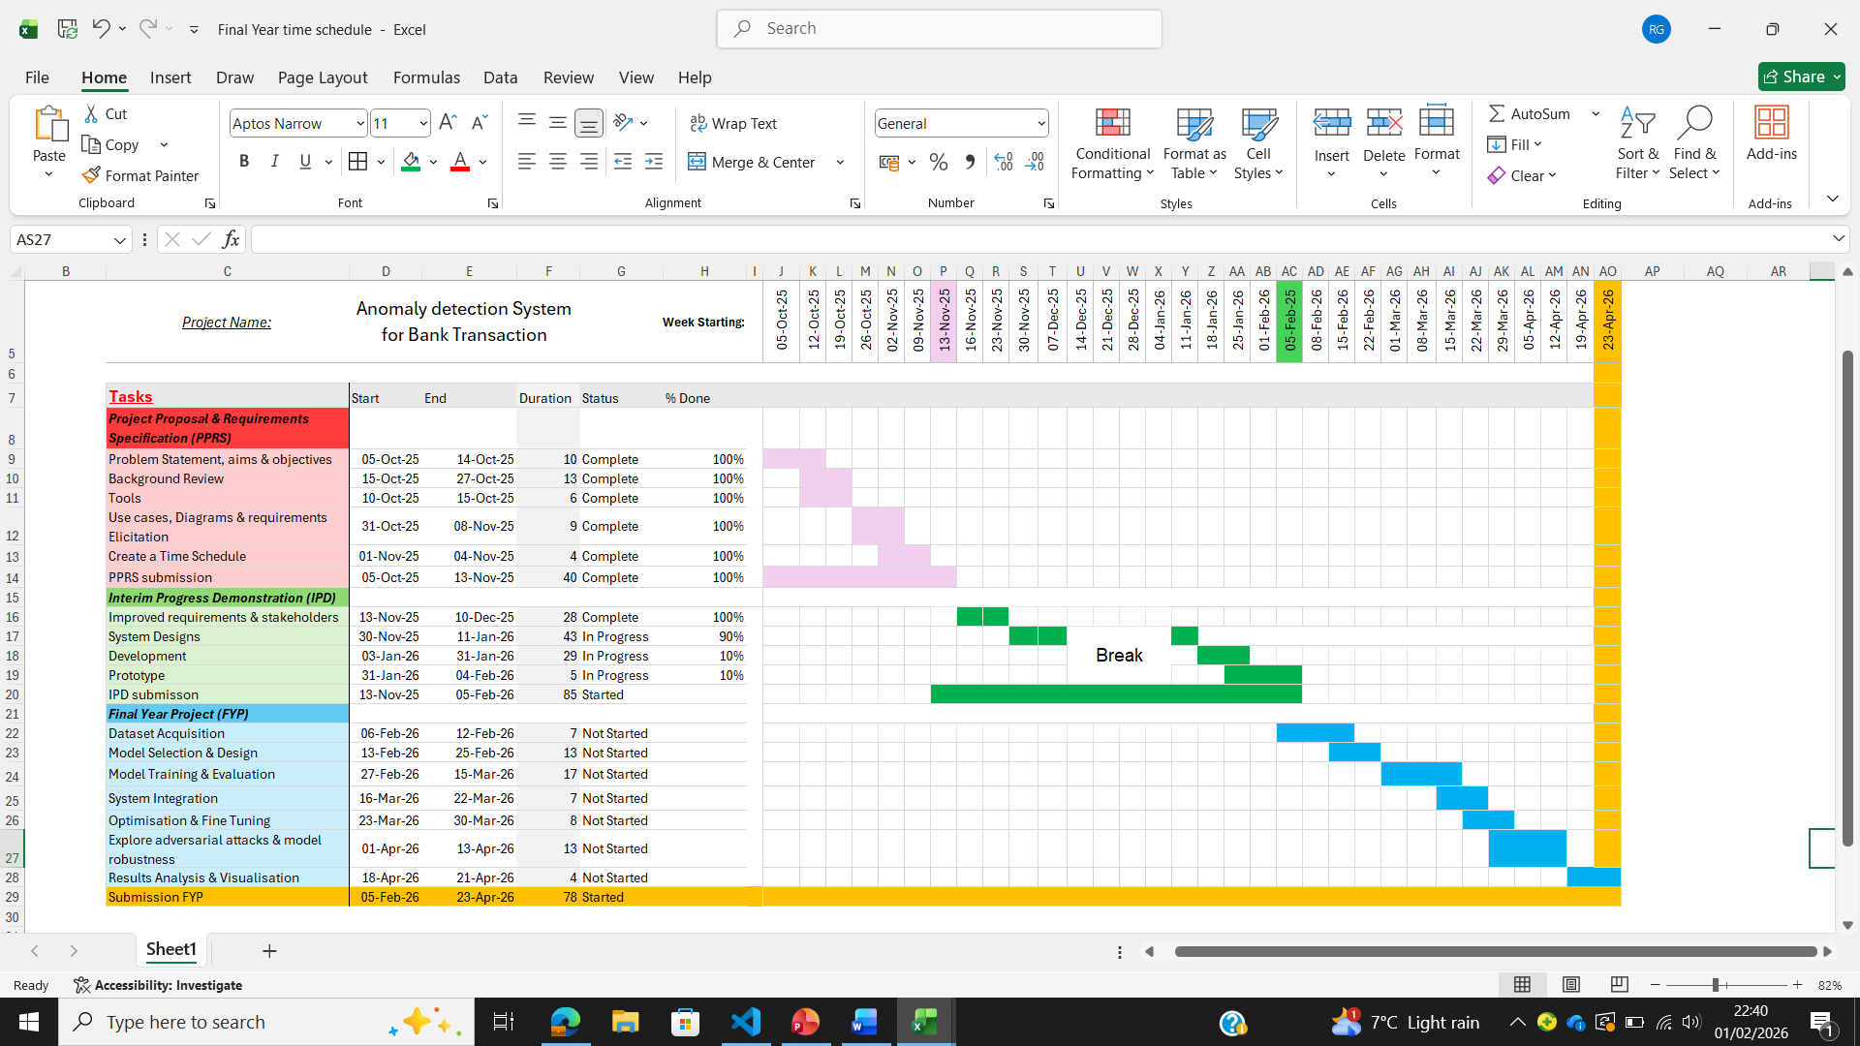
Updated Gantt Chart

Slide 16



Prototype
Jupyter Notebook for implementation
Programming Language: Python
Development so far:
Uploading & loading Dataset in Jupyter Notebook
Preprocessing data

